Slide 1
ANZ Assignment - Vijay Iyer

Slide 2
Task 1
To know which customers the bank should provide services, I analyzed the data and used the attribute “Value” to derive the insights.
The reason to use just “Value” attribute is that there is not enough attribute to look into.
“Value” attribute gives an insight on the tender contract value the government agency or the supplier has.
Doing an aggregation of contract value would give us an insight the leading government agencies and supplier can target and deal business with it.

Slide 3
Task 1
Since all the government agencies are Australian we can directly provide service to top 10 (an assumption that we are focusing on top 10 government agencies and suppliers each initially) government agency with highest aggregation of values of tender contract they have given.
On the other hand, there are suppliers who belong to Australia and outside Australia. Assuming, the bank wants to deal with local suppliers and then gradually expanding their business to, we can select top 10 suppliers with highest aggregation of values of tender contracts they have.

Slide 4
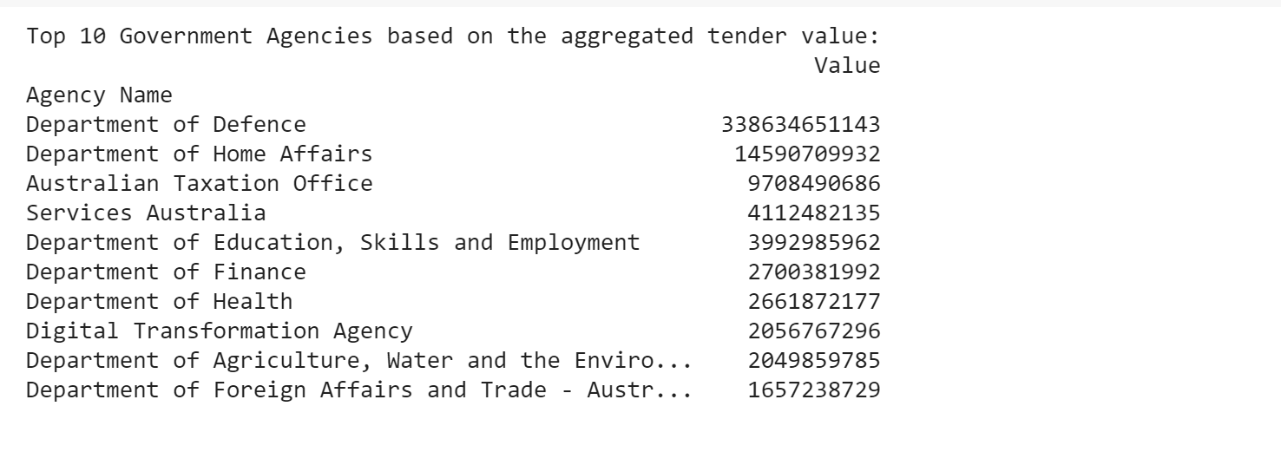
Task 1 - Results
These are top 10 government agencies with highest aggregated tender contract. (Values is in $)
Department of Defense has the highest aggregated contract tender value of 338 billion dollars.

Slide 5
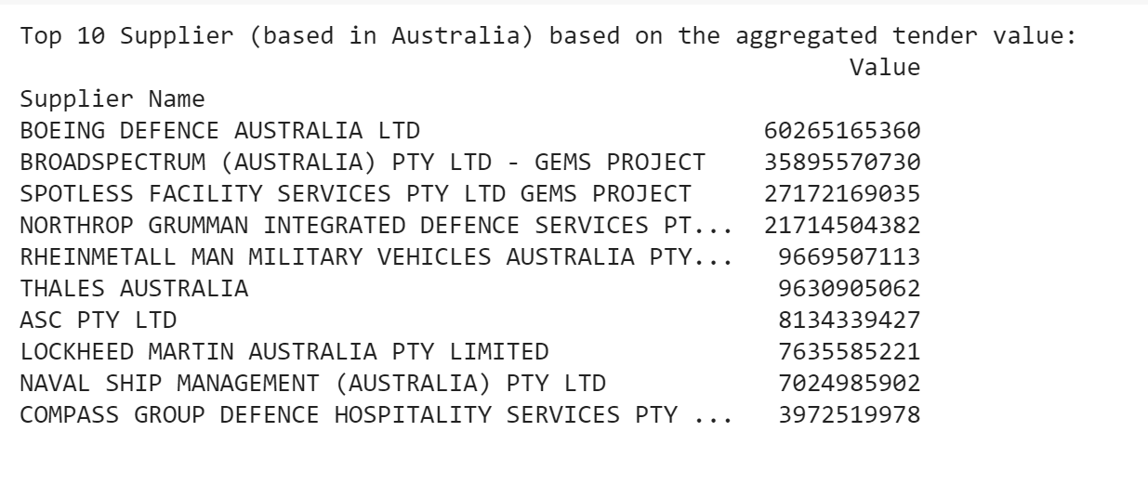
Task 1 - Results
These are top 10 supplier agencies with highest aggregated tender contract. (Values is in $)
Boeing Defense Australia LTD has the aggregated tender contract value of 60 billion dollars.

Slide 6
Task 2
To proceed with task 2, we need latitude and longitude of the zip code of original dataset.
For this, an additional dataset “Australian Postcodes” is used, which provides all the information needed for plotting the location of government agencies and suppliers

Slide 7
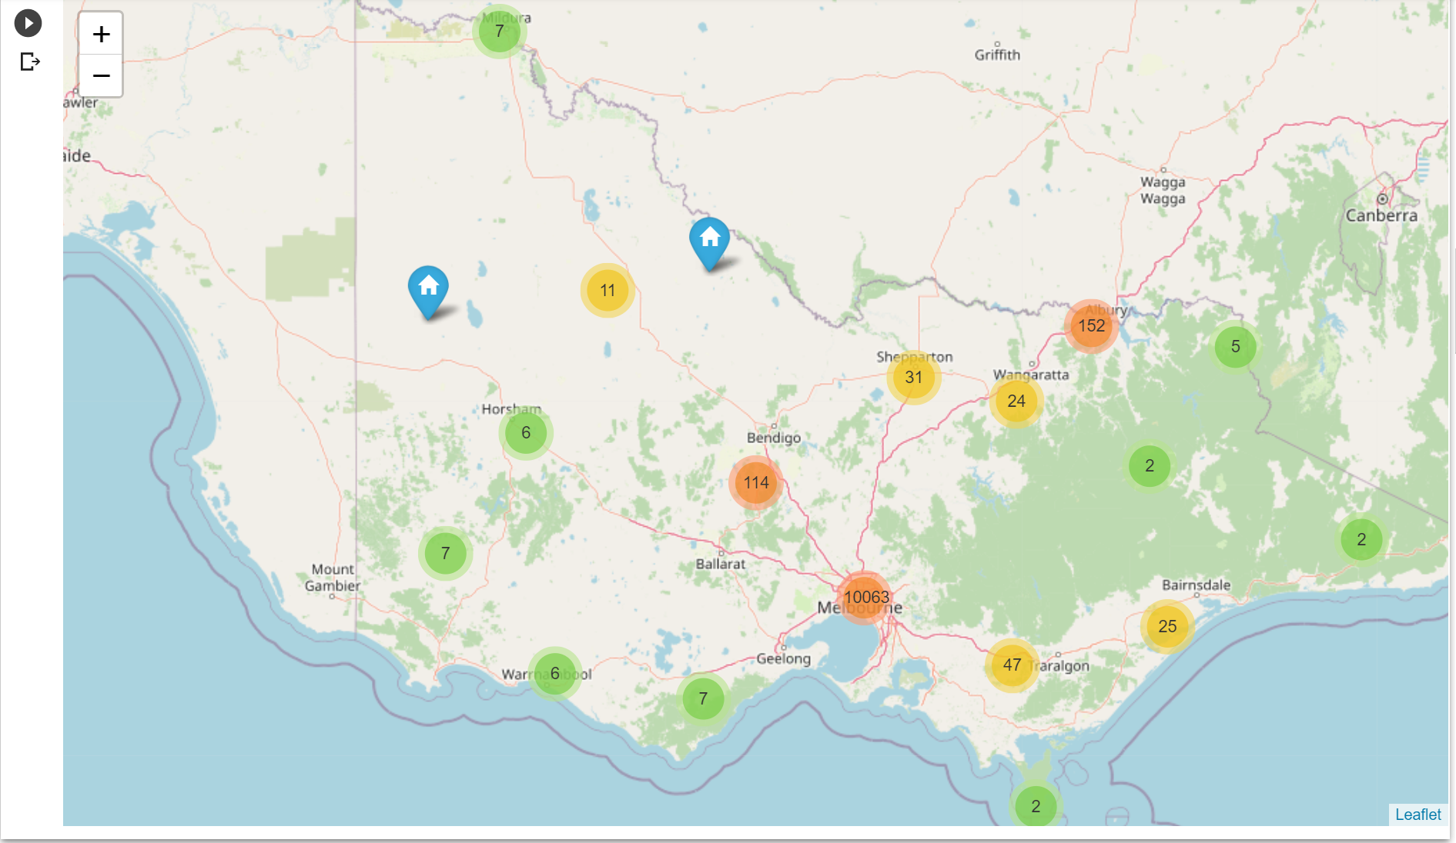
Task 2 - Supplier Location in Victoria
In Victoria, the supplier location is distributed all across but there are 4 main clusters near Melbourne CBD, Bendigo, Wodonga and Traralagon. So if the bank is looking to set up offices, they can set up at these locations and for Melbourne CBD, suburb like St Kilda or Hawthorn can be looked into.

Slide 8
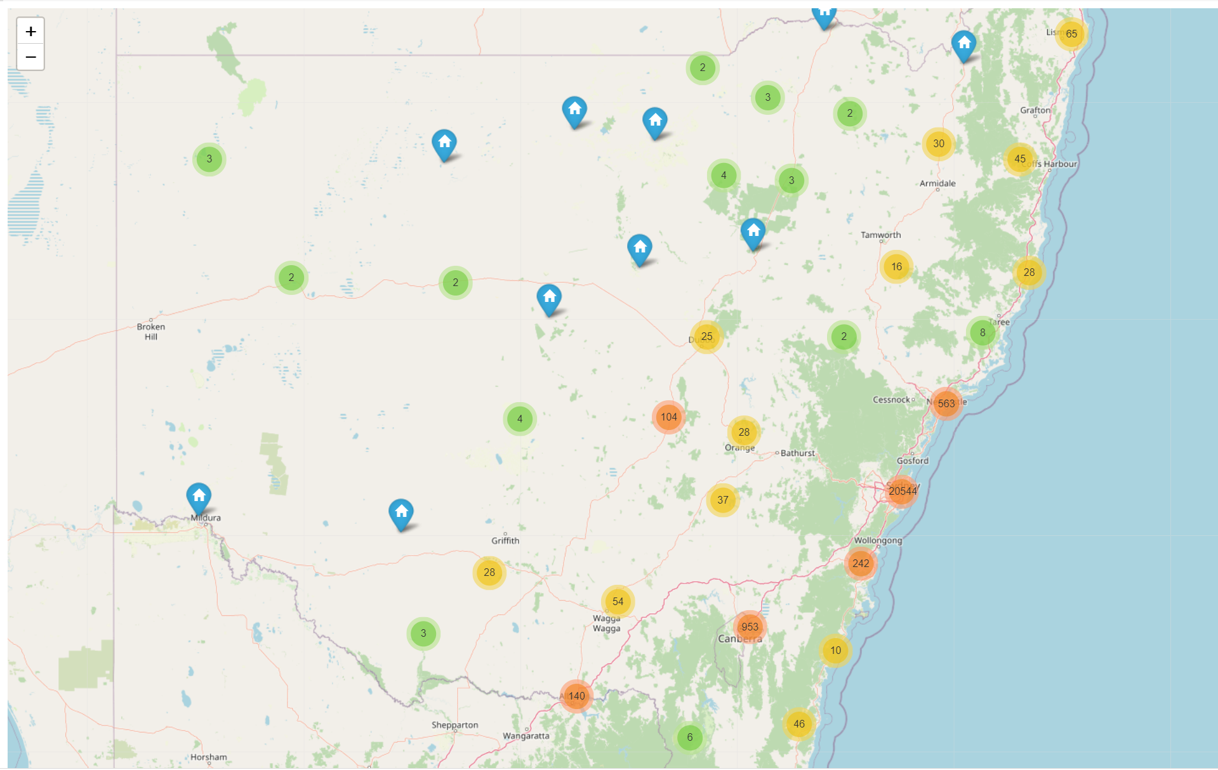
Task 2 - Supplier Location in NSW
In NSW, the main clusters are near Wollolong, Sydney CBD, Newcastle and Queanbeyan. We can set up office near these locations and for Queanbeyan, we can avoid since it is near ACT and we will be setting up one there. For Sydney CBD, we can look for cheaper suburbs like North Ryde or Parramatta can be looked into.

Slide 9
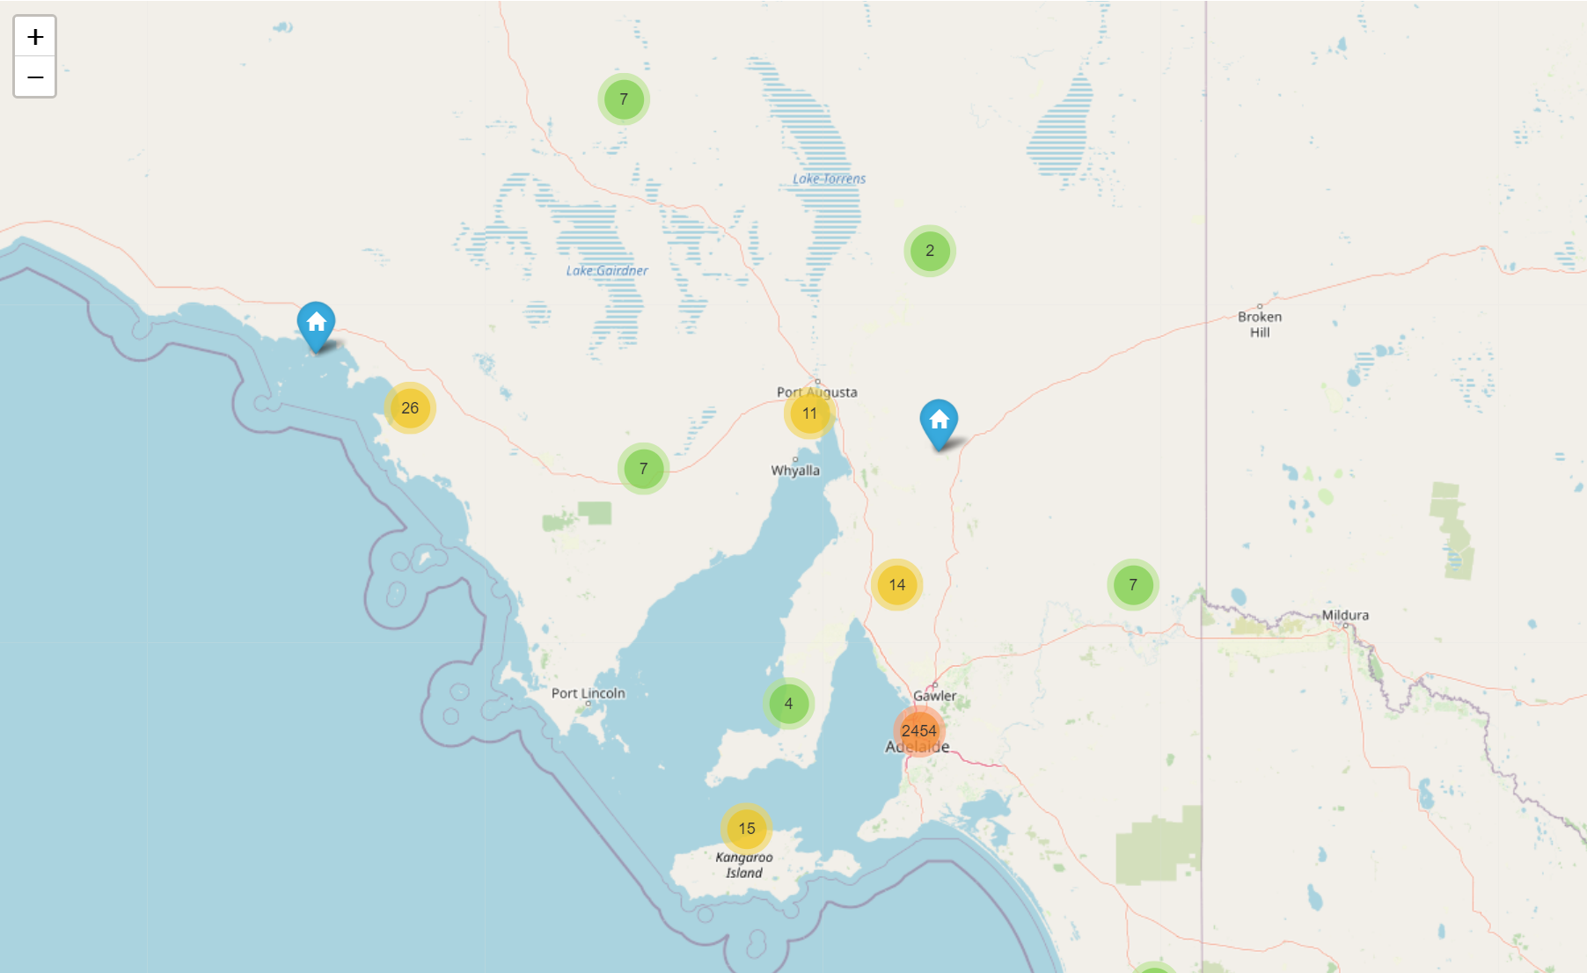
Task 2 – Supplier Location in South Australia
In SA, there is only one main cluster near Adelaide CBD and rest of the supplier are scattered around. It would be optimal to set up one office near Adelaide CBD like Pooraka or Elizabeth

Slide 10
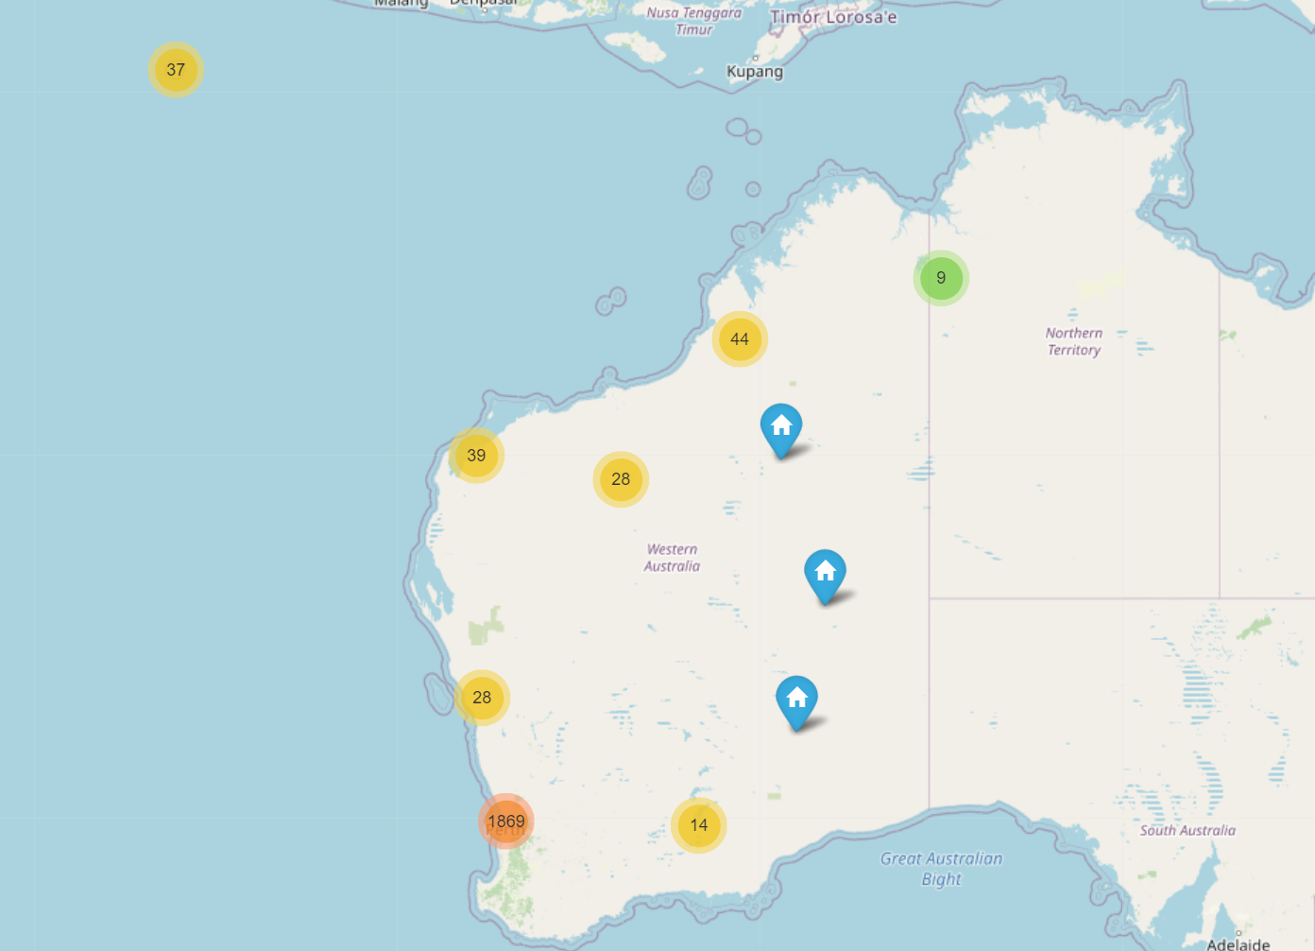
Task 2 – Supplier Location in Western Australia
In WA, the main cluster is near Perth CBD. There are small clusters near Karratha and Christmas Island. The bank can look to set up 2 office – one near CBD like Joondalup and one at Karratha.

Slide 11
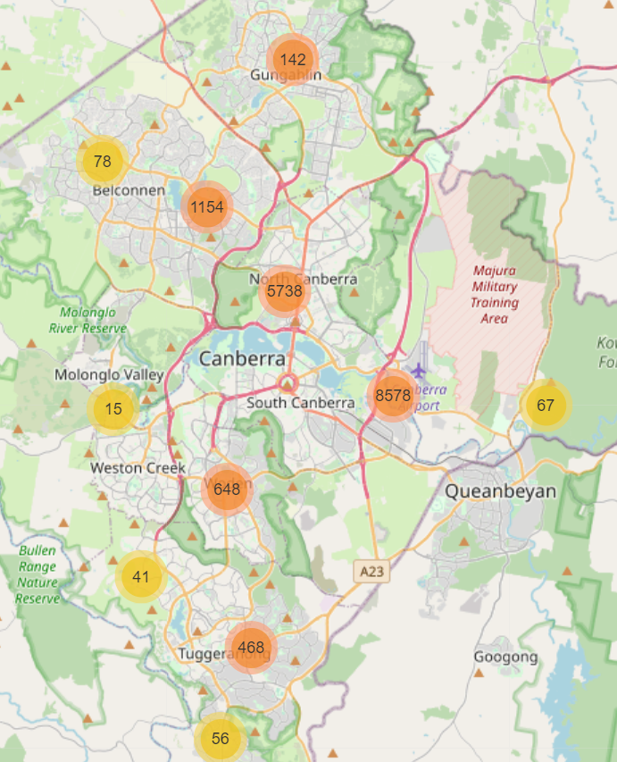
Task 2 – Supplier Location in Australian Capital Territory
In ACT, there are 3 main clusters of suppliers, one near North Canberra, one near Canberra Airport and one near Woden. The bank can look to set up 3 different office location, but the best location would be near Canberra Airport or near North Canberra.

Slide 12
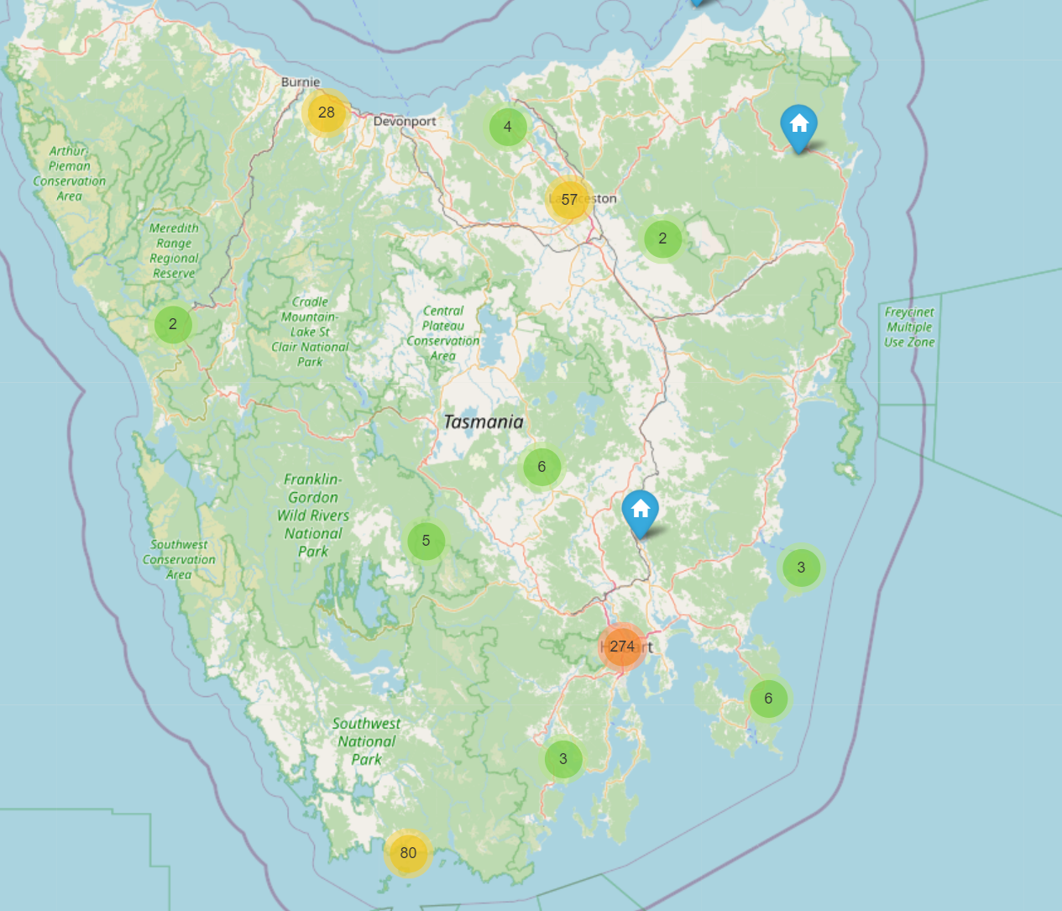
Task 2 – Supplier Location in Tasmania
In Tasmania, the bank can look to set up office near Hobart CBD, as that’s a main cluster of just 274 suppliers. Suburbs like Moonah or Glenorchy can be looked for cheaper alternatives.

Slide 13
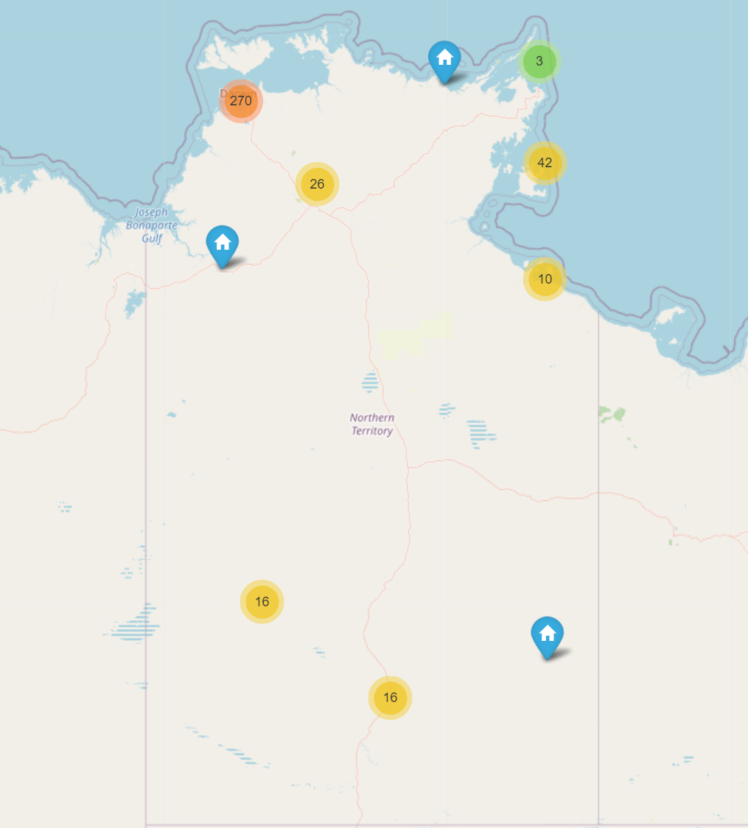
Task 2 – Supplier location in Northern Territory
In NT, there are 2 main clusters, one near Darwin and another near Alice Springs. Office location like Alice springs and Palmerston can be looked for.

Slide 14
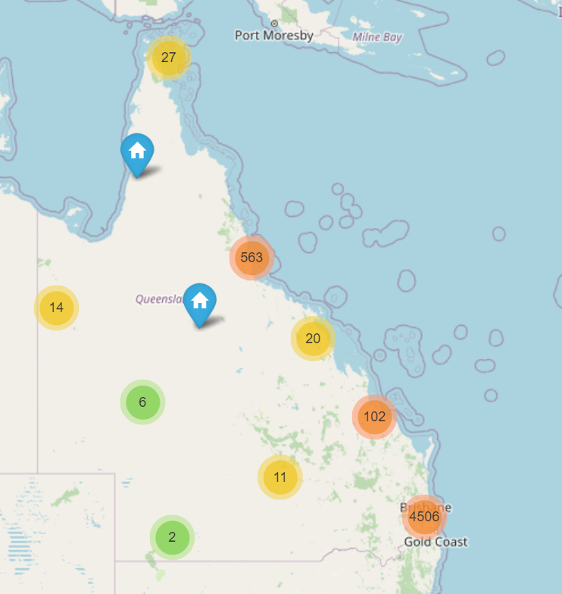
Task 2 – Supplier location in Queensland
In Queensland, there are two main clusters of suppliers, one near Brisbane and other near Cairns. The bank can look into Cairns and suburbs like Logan City or Ipswich near Brisbane CBD.

Slide 15
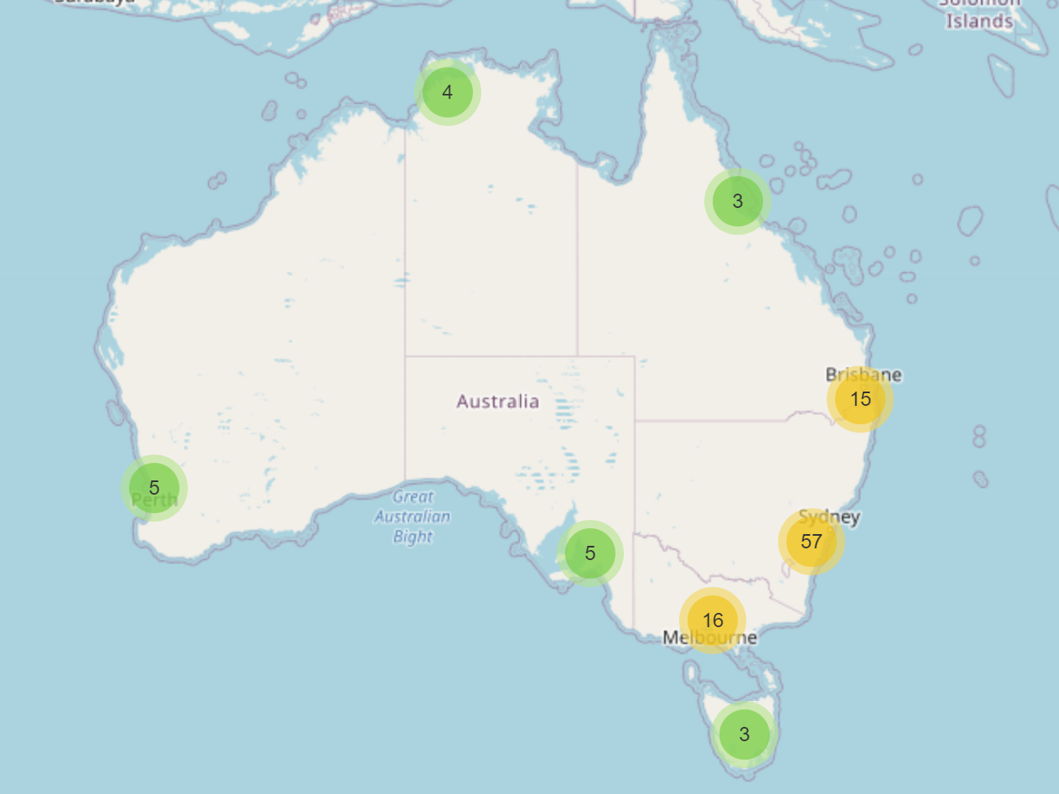
Task 2 – Government Agencies Location
For Government Agencies, their location is pretty much similar to supplier location, but in small numbers. So the office location decided for suppliers will also be for government agencies.

Slide 16
Machine Learning Use Case
Use of clustering and technique called regionalization to understand the demographics where the services to be targeted for the suppliers in the future.
Using the statistical attributes like suppliers tender contract value, their UNSPSC Contract title and other attributes and using their spatial region, the clusters can be spatially segregated giving an idea on the regions performance over the years and where we can target our business services in the future

Slide 17
Machine Learning Use Case (Continued)
Approach here is to use the unsupervised machine learning algorithms like different forms of clustering to split the dataset into groups of observations that are similar within the group and dissimilar between with an additional constraint of spatial neighbors.
Semi Supervised machine learning algorithm Reg K-means algorithm can be used which is basically K-means for regionalization by specifying contiguity constraints based on a neighborhood representation.

Slide 18
Machine Learning Use Case (Continued)
Pro/Cons:
More than disadvantages, there is lot of constraints in handling the regional clustering or regionalization. They are:
Ensuring Spatial Contiguity of each region,
Deciding on homogenous regions to be formed

Slide 19
THANK YOU!!

